Slide 1

Retail Revelations: Navigating Superstore Insights
-Priyesh Subhash Patil
AICTE ID: STU61724cd0bbae61634880720

Slide 2

PROBLEM STATEMENT
This project aims to unlock the hidden potential within a retail superstore by conducting a thorough analysis of its sales data.
we aim to identify areas where performance can be improved and develop data-driven strategies to aggressively boost sales in underperforming regions and customer segments.
Our ultimate goal is to maximize overall profit through informed pricing and cost analysis.
By addressing these issues, we can gain a competitive edge and drive sustainable growth for the retail superstore.

Slide 3
Project Description
This project dives into sales data from a retail superstore to uncover trends and opportunities for growth. We analyzed:
Regional Sales Performance
The Western region leads, but there's potential to improve in others.
Product Category Performance
Technology is a top seller, but profitability across categories needs evaluation.
Customer Segmentation
The consumer segment has the most sales, but strategies are needed to attract Corporate and Home Office segments.
Shipping Mode Distribution
Second Class Shipping is popular, but exploring alternative options could be beneficial.

Slide 4
Project Description
Key Takeaways:
Bridge regional sales gaps.
Optimize product offerings based on profitability.
Develop targeted marketing campaigns for specific segments.
Analyze customer preferences for alternative shipping options.
Maximize profit through cost analysis and pricing strategies.
This data-driven approach paves the way for informed decision-making and improved retail performance.

Slide 5

WHO ARE THE END USERS?
Retail Executives: CEO, CFO, COO.
Customers
Marketing Teams
Sales Teams
Category Managers
Logistics and Operations Teams
Data Analysts/Scientists
Business Intelligence Professionals
Investors and Stakeholders

Slide 6

Technology Used
The technology stack used in this retail analytics project includes:
Programming Language: Python for data manipulation, analysis, and visualization.
Libraries: 1) Pandas for data manipulation.
2) NumPy for numerical operations.
3) Matplotlib and Seaborn for data visualization.
Data Storage: CSV (Comma-Separated Values) file format for storing and accessing the dataset.
Integrated Development Environment (IDE): Jupyter Notebooks for interactive and collaborative development.
Data Import/Export Tools: Depending on the data format (CSV, Excel, etc.)

Slide 7
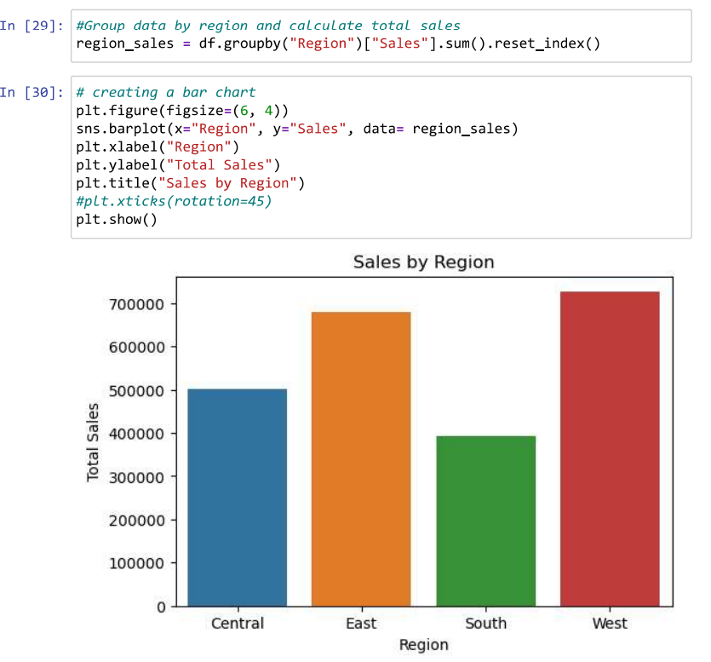
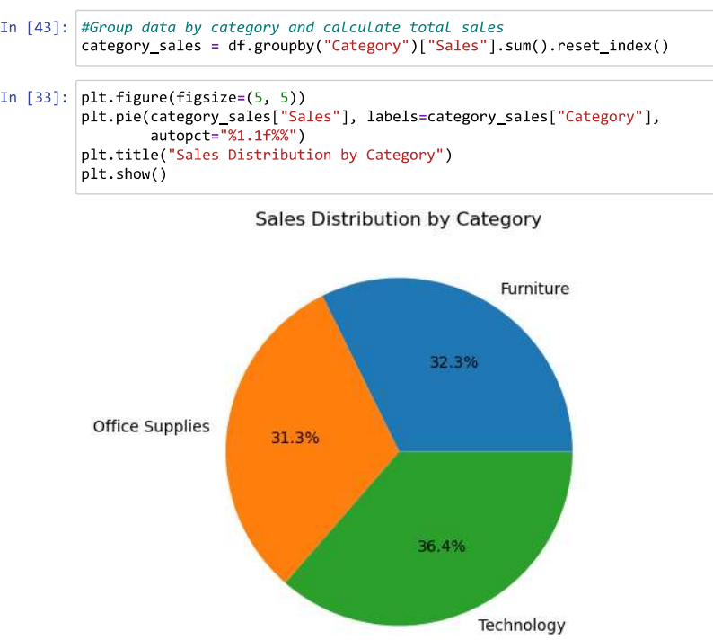
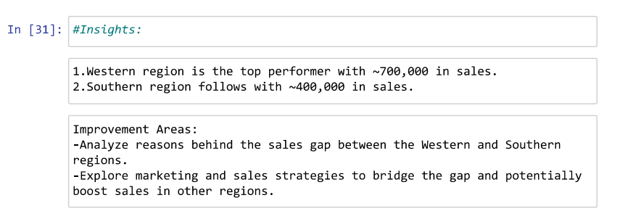
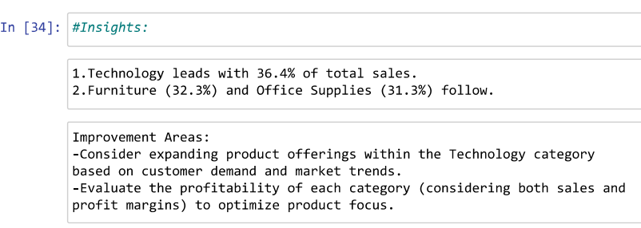
RESULTS

Slide 8
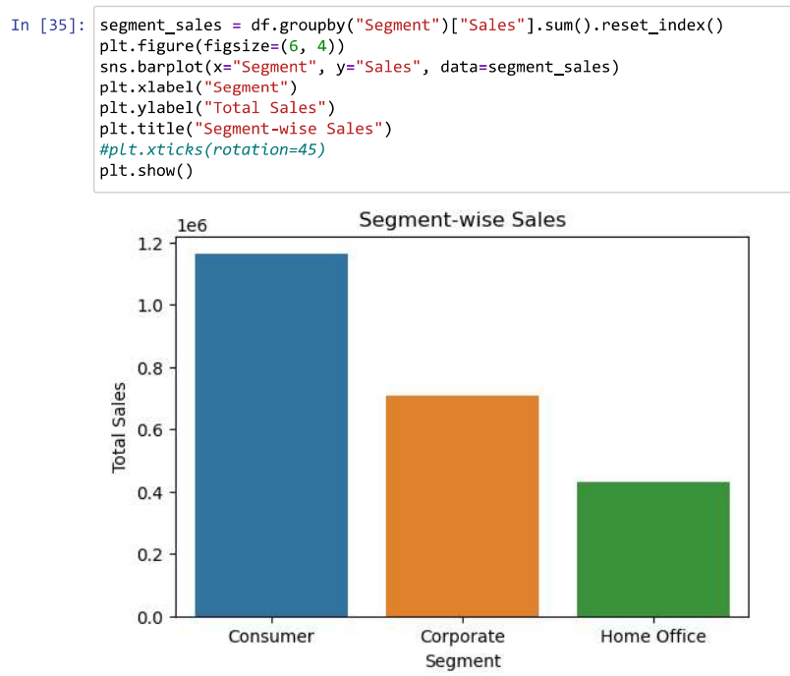
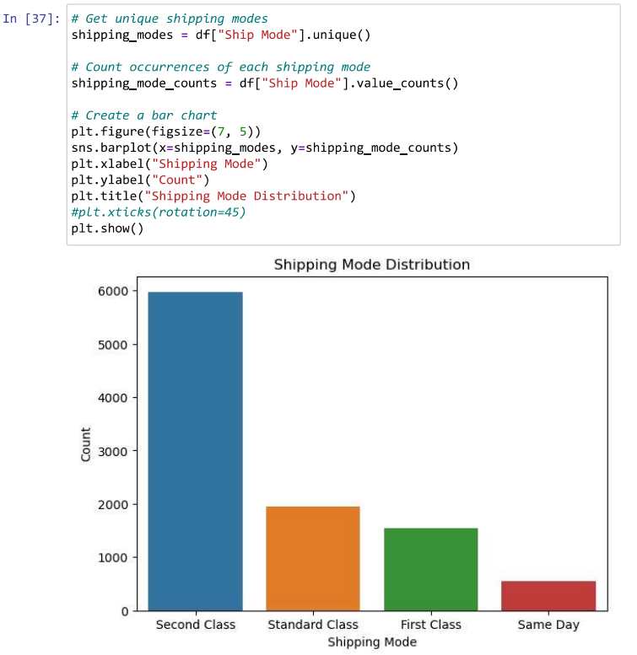
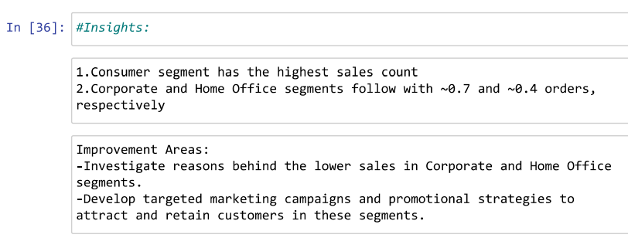
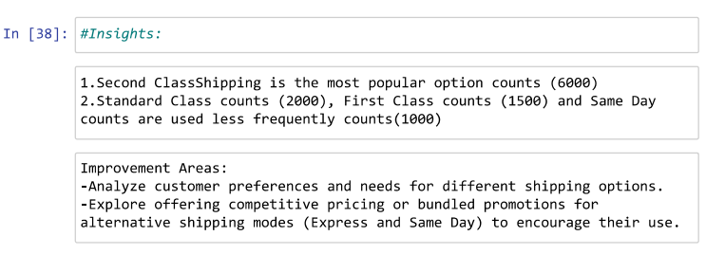
RESULTS

Slide 9
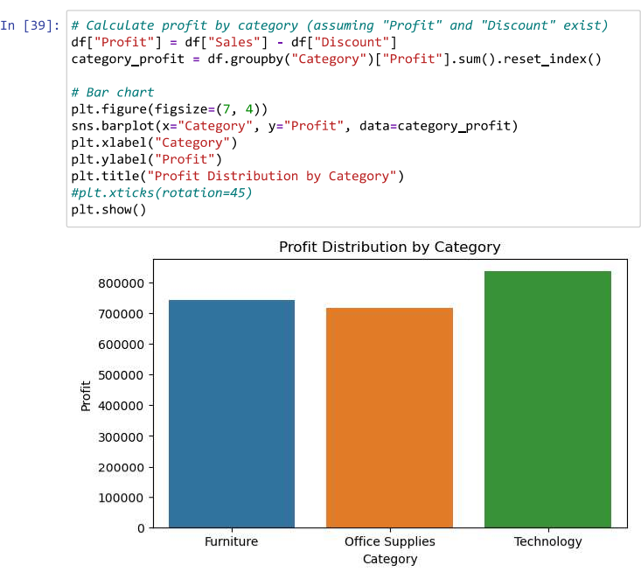
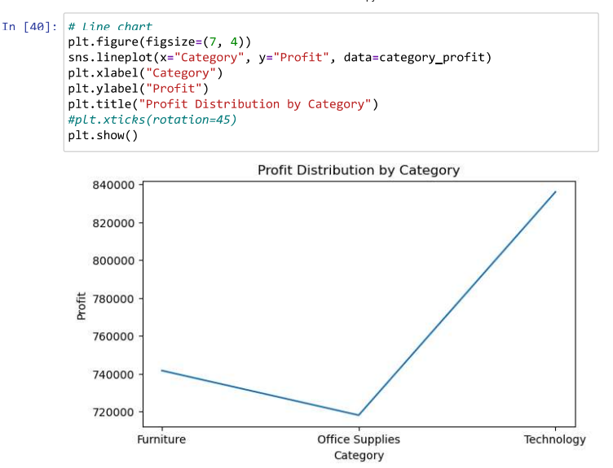
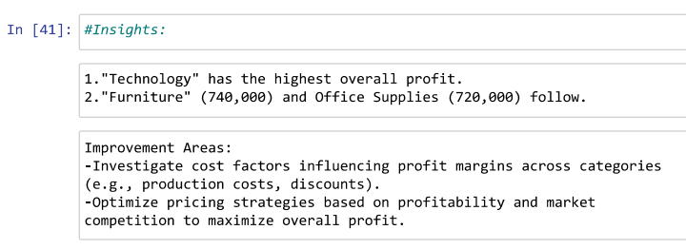
RESULTS

Slide 10
Thank you
Any Questions?
.
.

